Slide 1
A Brief Introduction to PyTorch (a deep learning library)
Huaipeng Zhao
pytorch.org

Slide 2
Outline
Why Deep Learning Libraries and Why PyTorch ?
A Brief Introduction to PyTorch
PyTorch in action

Slide 3
Outline
Why Deep Learning Libraries and Why PyTorch ?
A Brief Introduction to PyTorch
PyTorch in action

Slide 4
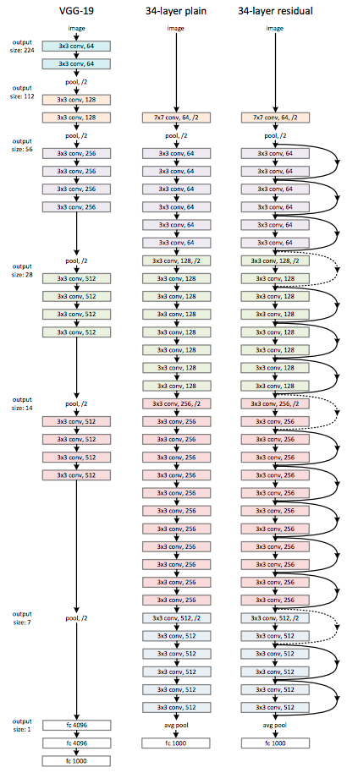
Why a DL Library is Necessary?
Complicated DL architectures
Easily build big computational graphs
Easily compute gradients

Slide 5
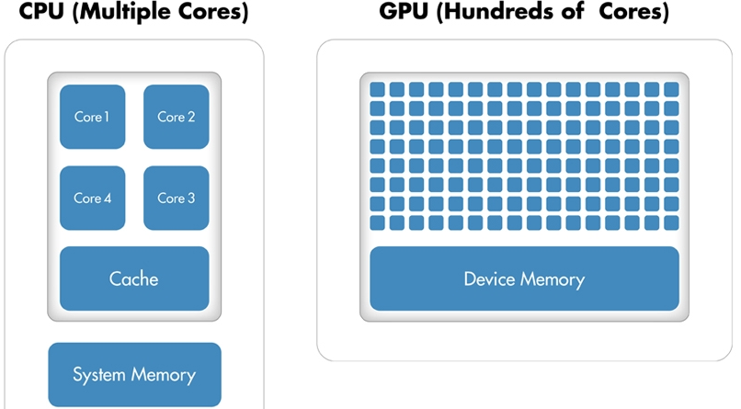
Why a DL Library is Necessary?
Run it all efficiently on GPU

Slide 6


Popular Deep Learning Libraries

Slide 7

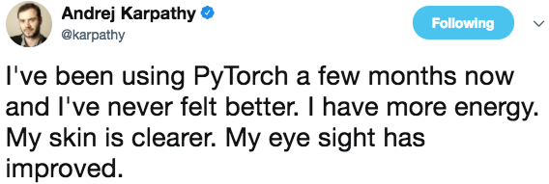
Why
Life is short, you need

Slide 8
Why
Support Python
Dynamic Graph
Friendly API for research
Easily debug
Love all things [Pythonic]

Slide 9
Outline
Why Deep Learning Libraries and Why PyTorch ?
A Brief Introduction to PyTorch
PyTorch in action

Slide 10
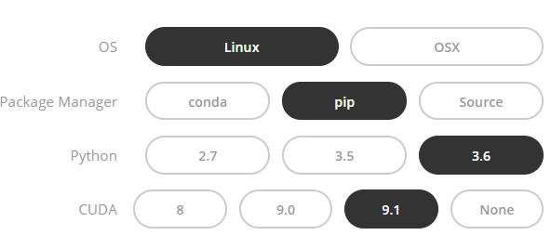
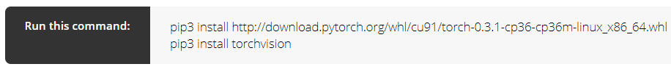
Installing

Slide 11
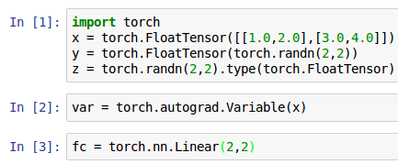
Three Levels of Abstraction
Tensor: Imperative ndarray
Variable: Node in a computational graph (data,grad)
Module: A neural network layer

Slide 12
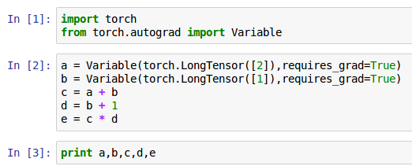
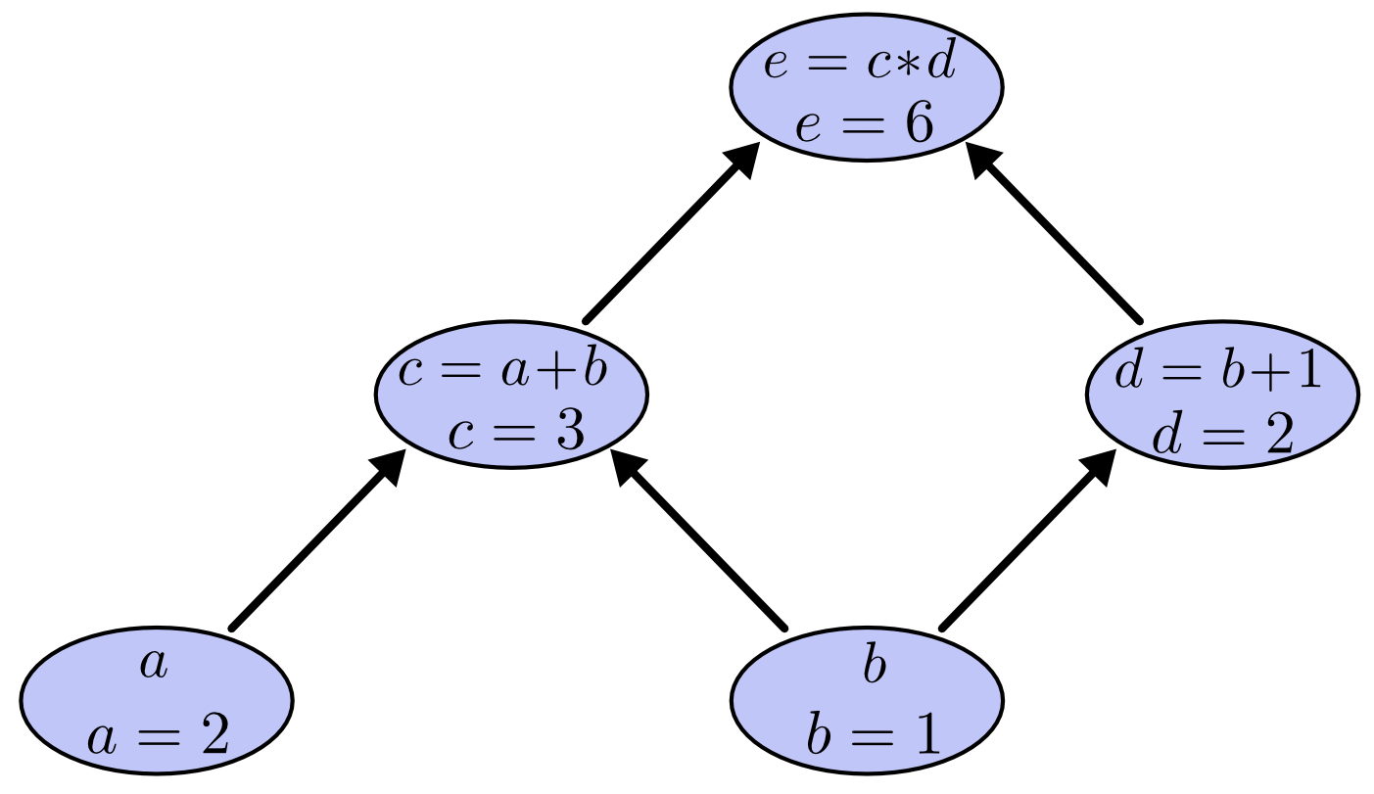
A Toy Neural Network
Forward

Slide 13
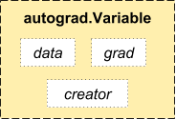
A Toy Neural Network
Forward
Tensor

Slide 14
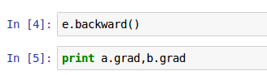
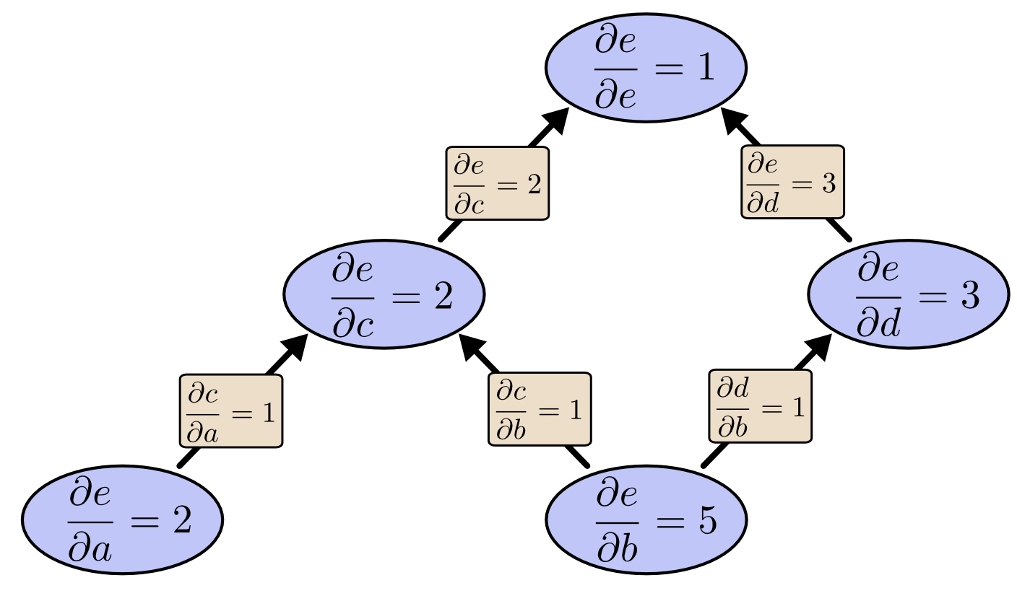
A Toy Neural Network
Backward

Slide 15
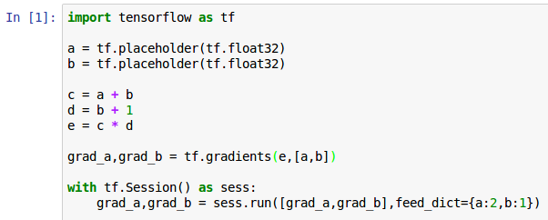
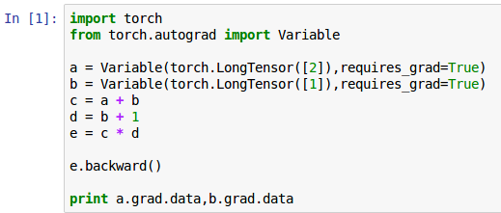
A Toy Neural Network

Slide 16
Major Components of PyTorch
Package | Description
torch | a Tensor library like NumPy, with strong GPU support
torch.autograd | a tape based automatic differentiation library that supports all differentiable Tensor operations in torch
torch.nn | a neural networks library deeply integrated with autograd designed for maximum flexibility
torch.optim | an optimization package to be used with torch.nn with standard optimization methods such as SGD, RMSProp, LBFGS, Adam etc.
torch.utils | DataLoader, Dataset and other utility functions for convenience

Slide 17
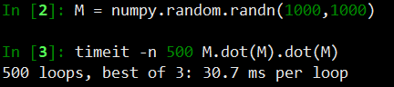
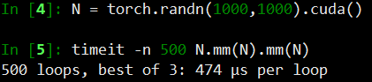
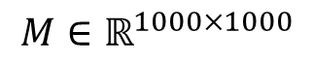

Torch Module:PyTorch as A Tensor Library
Tensor operations: slicing, indexing, math operations, linear algebra, reductions
CPU & GPU
Fast! (comparison on speed of matrix multiplication)
$$M∗M∗M$$
$$M∈ℝ^{1000×1000}$$
Numpy
PyTorch

Slide 18
Torch.nn : a neural networks library
Containers | Module, Sequential,ModuleList,ParameterList
Convolution Layers | Conv1d,Conv2d,Conv3d…
Recurrent Layers | RNN,LSTM,GRU,RNNCell…
Linear Layers | Linear, Bilinear
Non-linear Activations | ReLU,Sigmoid,Tanh,LeakyReLU…
Loss Functions | NLLLoss,BCELoss,CrossEntropyLoss…

Slide 19
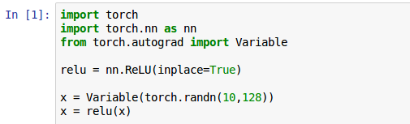
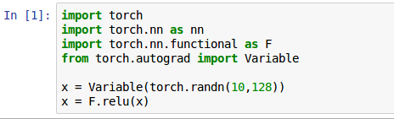
Torch.nn.functional
Torch.nn
Torch.nn.functional

Slide 20
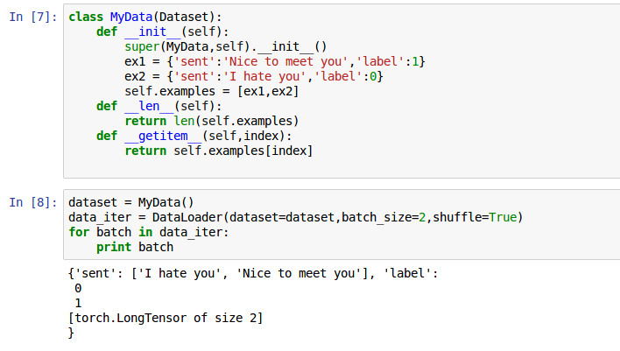
How to load dataset?

Slide 21
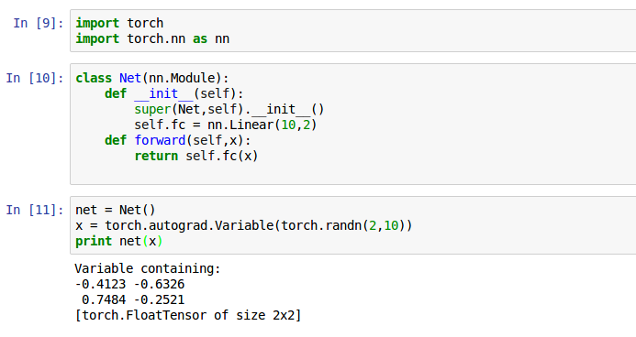
How to build a model?

Slide 22
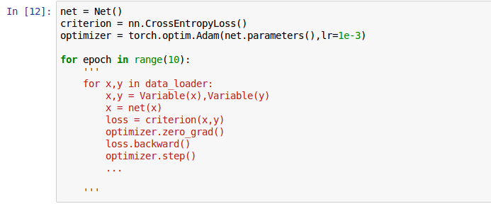
How to train a model?

Slide 23
Outline
Why Deep Learning Libraries and Why PyTorch ?
A Brief Introduction to PyTorch
PyTorch in action

Slide 24
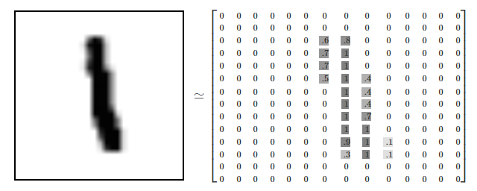
MNIST Dataset

Slide 25
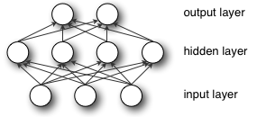
MLP for MNIST (0-d features)
10
64
28*28

Slide 26
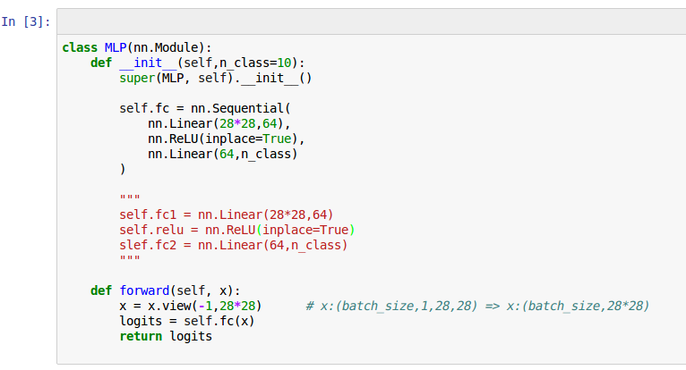
MLP for MNIST
Last Test Acc: 95.8%

Slide 27
RNN for MNIST (1-d features)
GRU
GRU
…
GRU
28
…
28

Slide 28
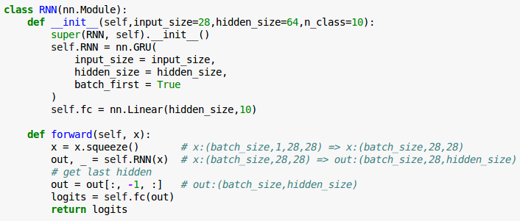
RNN for MNIST
Last Test Acc: 97.7%

Slide 29
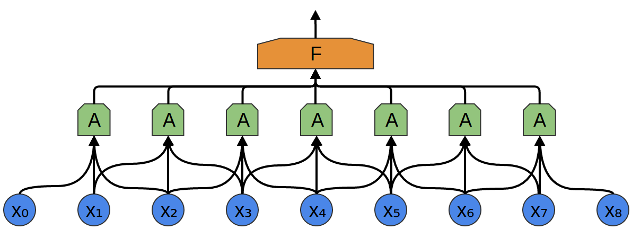

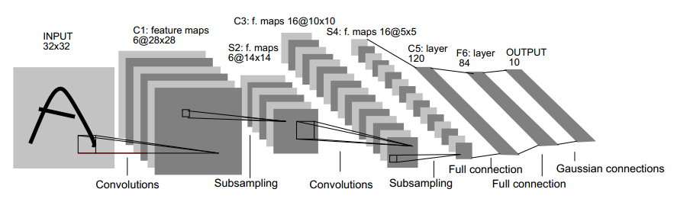
CNN for MNIST (2-d features)

Slide 30
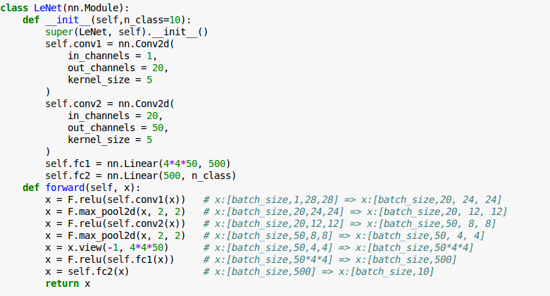
CNN for MNIST
Last Test Acc: 99.2%

Slide 31
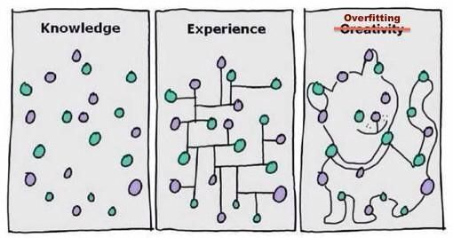
Assignments
Try more models (Bi-LSTM,ResNet…)
L2 Regularization
Dropout
Data Argumentation
Batch Normalization
Try other optimization algorithms(SGD…)
Try more activation function(Tanh,Sigmoid…)

Slide 32
Resources
Official resources
Documentation http://pytorch.org/docs/master/
Tutorials http://pytorch.org/tutorials/index.html
Example projects https://github.com/pytorch/examples
Github code
fairseq-py
OpenNMT-py
Open courses and blogs
Stanford CS231N 2017, Lecture 8 “Deep Learning Software”

